Slide 1
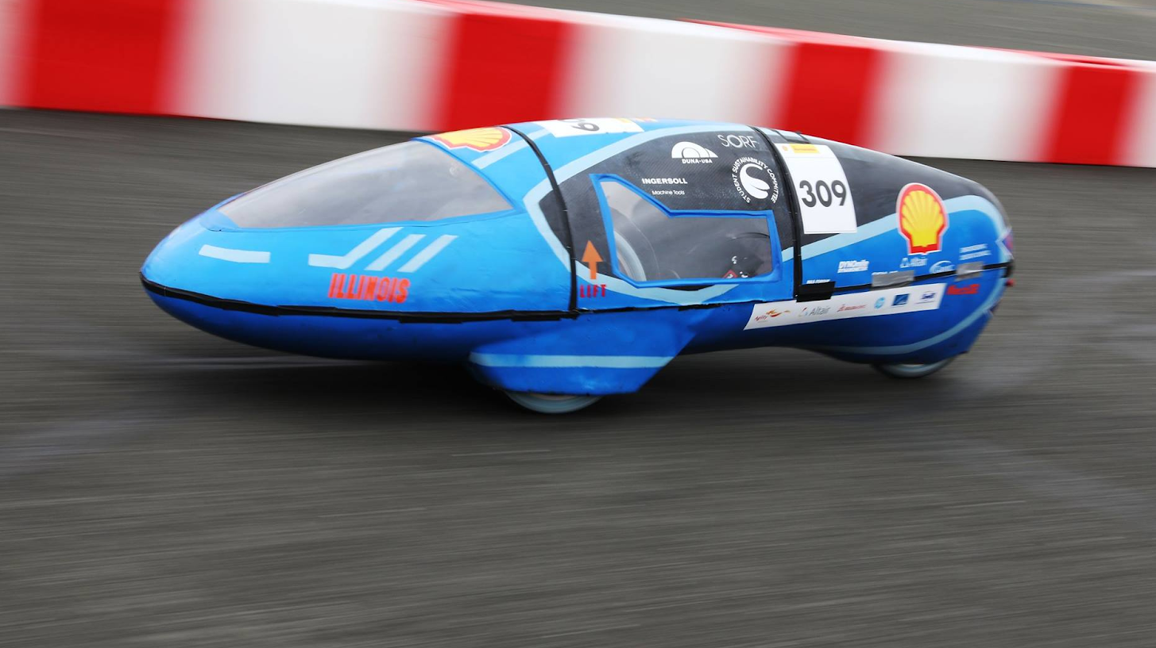

Eco Illini Supermileage
Week:
4/27/2020

Slide 2
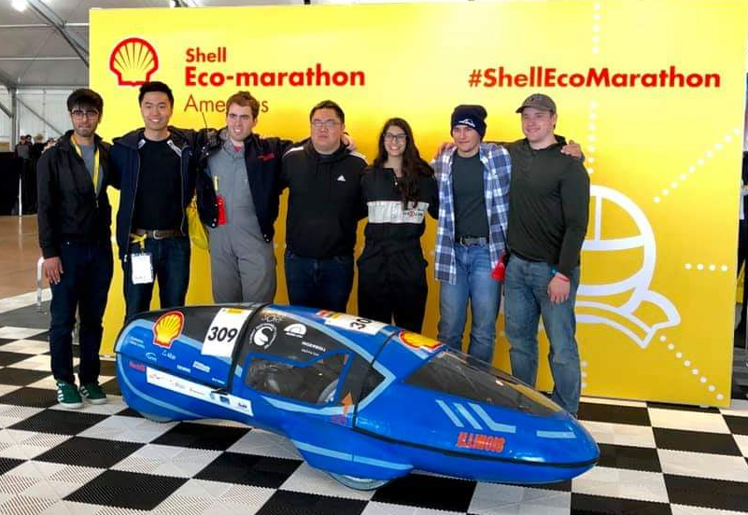
Timeline
Goals for the week:
Aero, Business Leads?
ELT 2021 Meeting
Begin work on Constitution/Bylaws
Unfortunately required to re-register RSO
This week in review (TWIR):
Meeting planned out: 5/2
Confirm time yet: when2meet
Team lead survey completed
Info from above integrated into website
Will be more carefully refined, the posted

Slide 3
Leadership Structure 2020-2021
Stefan Kamzol (President), Sr
Justin Kao (Captain), So
Michael Rhee (Treasurer), Jr
Bruno Funez (Safety Officer), So
Business/Social Lead
Luke Markuson (Mechanical Lead), So
Joshua Simpson-Gomez (Body Lead), Jr
Owen Shin (Electronics Lead), So
TBD (Aerodynamics Lead)
Jared Abbott (Engine Project Lead), Jr
Conrad Ku (Dynamics Project Lead), Jr
Brody Snook (Vehicle Testing Project Lead), So
Alex Ortwig (Eco/EV Electronics Advisor/Developer)

Slide 4
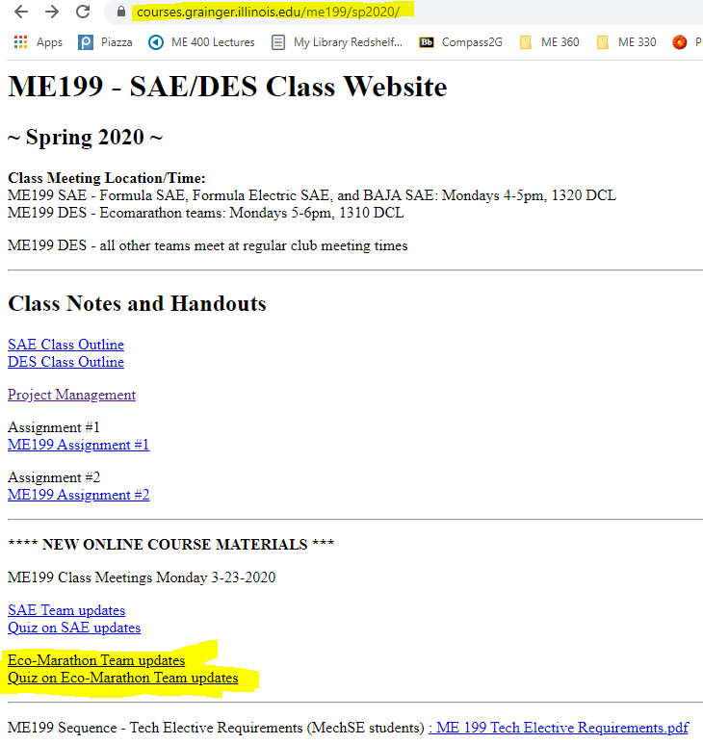
ME 199 and Class Participation
In-class participation suspended
Meetings temporarily on hold
Course Evaluation: (How we will evaluate/give you a grade)
Participation on projects/planning through the rest of SP 2020
Completed CAD Assemblies of projects
Email skamzol2@Illinois.edu for Solidworks
If unable to run, see below
Team Wiki:
Post project work, information/research, methods towards completing your project, and status of project → Why did you do what you did???
List where future development could be made (if any)
Paper: Write conclusion of where project is left at, steps needed to finish it, and rough time needed to assemble/test
Attendance: Take “Quiz”; based on these PPT’s!

Slide 5


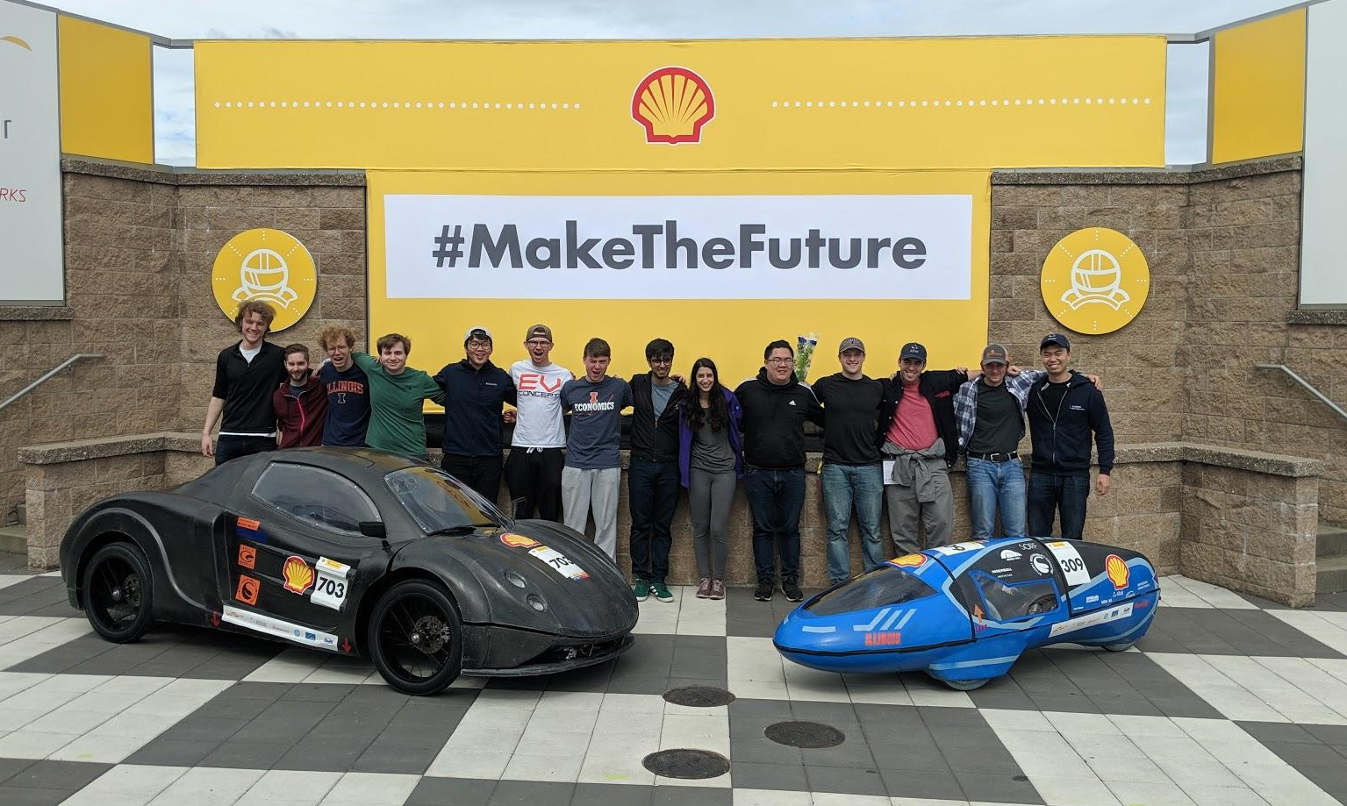


Slide 6
Administrative - Robert Mauge
Projects lead meeting held last week
Summer plan
Driving car by end of summer
Finish mechanical work
Carbon fiber rims, new suspension installation
Planning for every scenario regarding COVID-19
Focus on fundraising, new member recruitment
Focus on ensuring competition victory in any scenario (in person class resumes, is cancelled part way through, etc.)

Slide 7
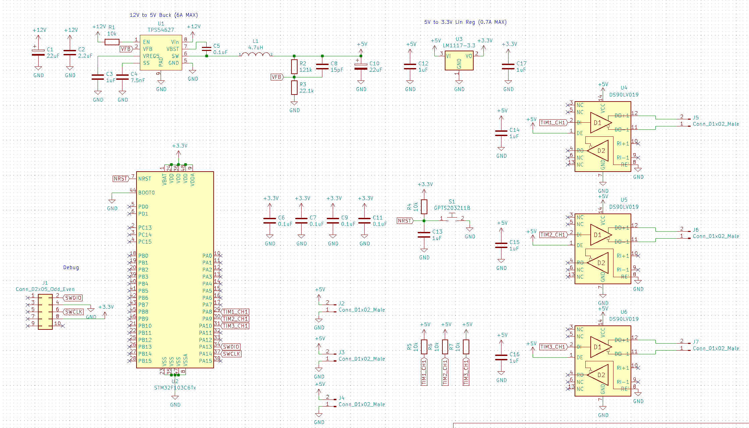
Electronics Team - Moving the Car
Finished Schematic for new light controller
Removes one of the two last arduino boards
Looking to remove the last one next(Dashboard)

Slide 8
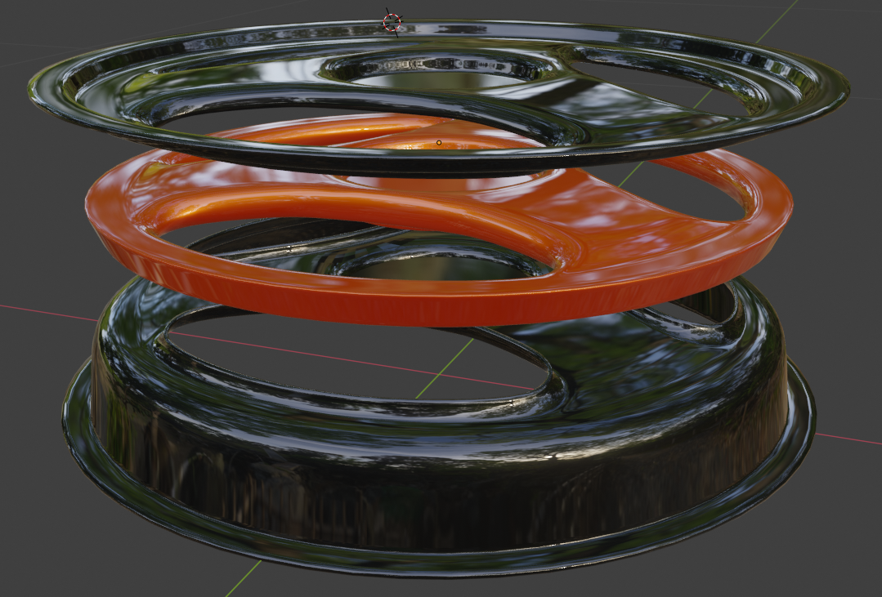
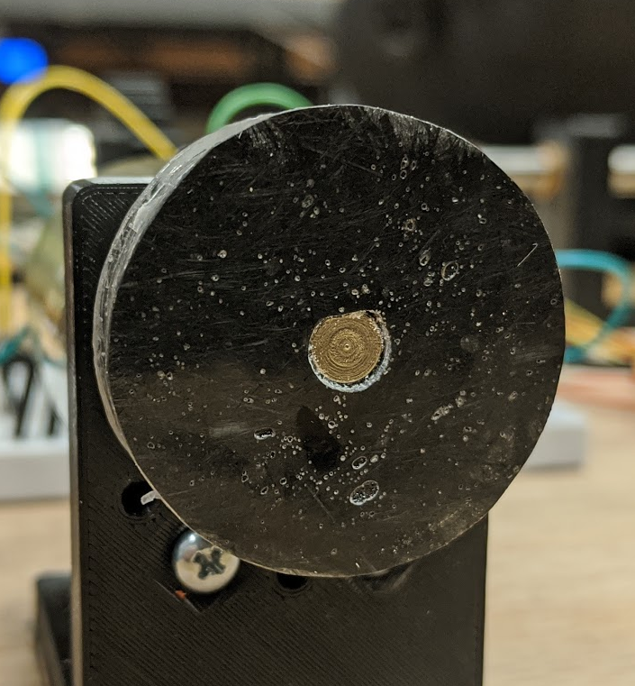
Composites Team - Richard Mauge
Third carbon fiber rim design in case the other 2 fail
Black pieces: woven carbon fiber
VARTM
6 layers, 0 60 -60 layup
9 layers, 0 60 -60 for rim outer edge
Orange piece: short strand cast
Solid casting
50% fiber volume short strand epoxy

Slide 9
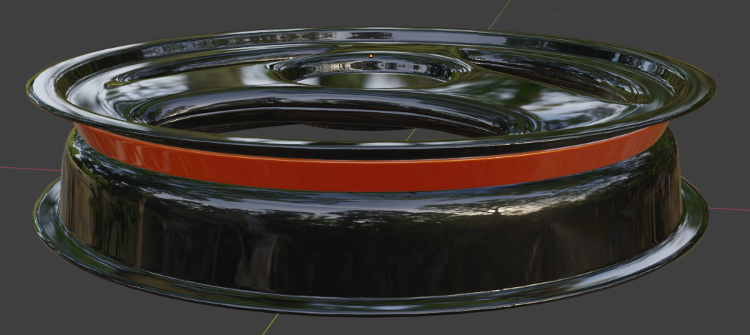
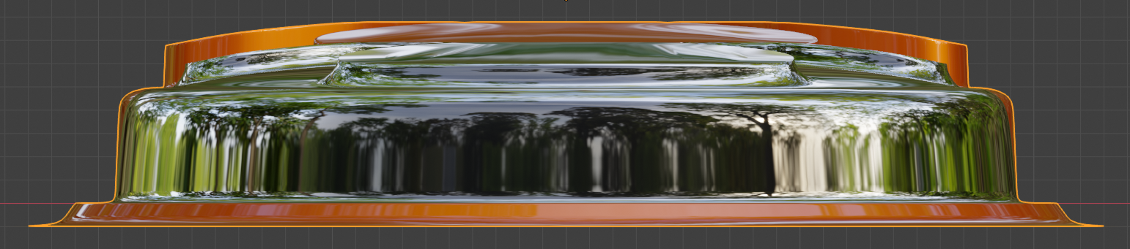
Composites Team - Richard Mauge
Benefits over previous 2 part design
No sharp corners or 90° angles
Easier to demold rim halves
Less material to machine
Easier to layup
Increased bond area between 2 halves
Much stiffer spokes
Solid outer wall, no holes for inner tube to inflate into

